Slide 1
The U.S. Election Assistance Commission
Don Palmer, Vice Chairman
May 29, 2020

Slide 2
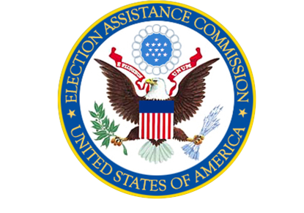
Our Mission
The U.S. Election Assistance Commission helps election officials improve the administration of elections and helps Americans participate in the voting process.

Slide 3
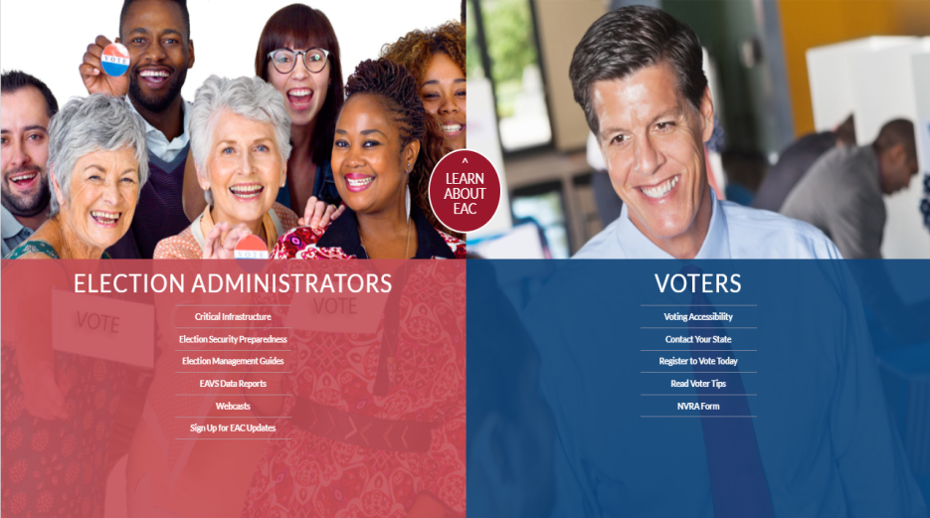
About the EAC
Independent, bipartisan Commission established by the Help America Vote Act (HAVA)
Develop guidance to meet HAVA requirements
Adopt voluntary voting system guidelines, certify voting systems and accredit testing laboratories
Serve as a national clearinghouse of information on election administration
Administer and Audit the use of HAVA grant funds – Security, COVID

Slide 4
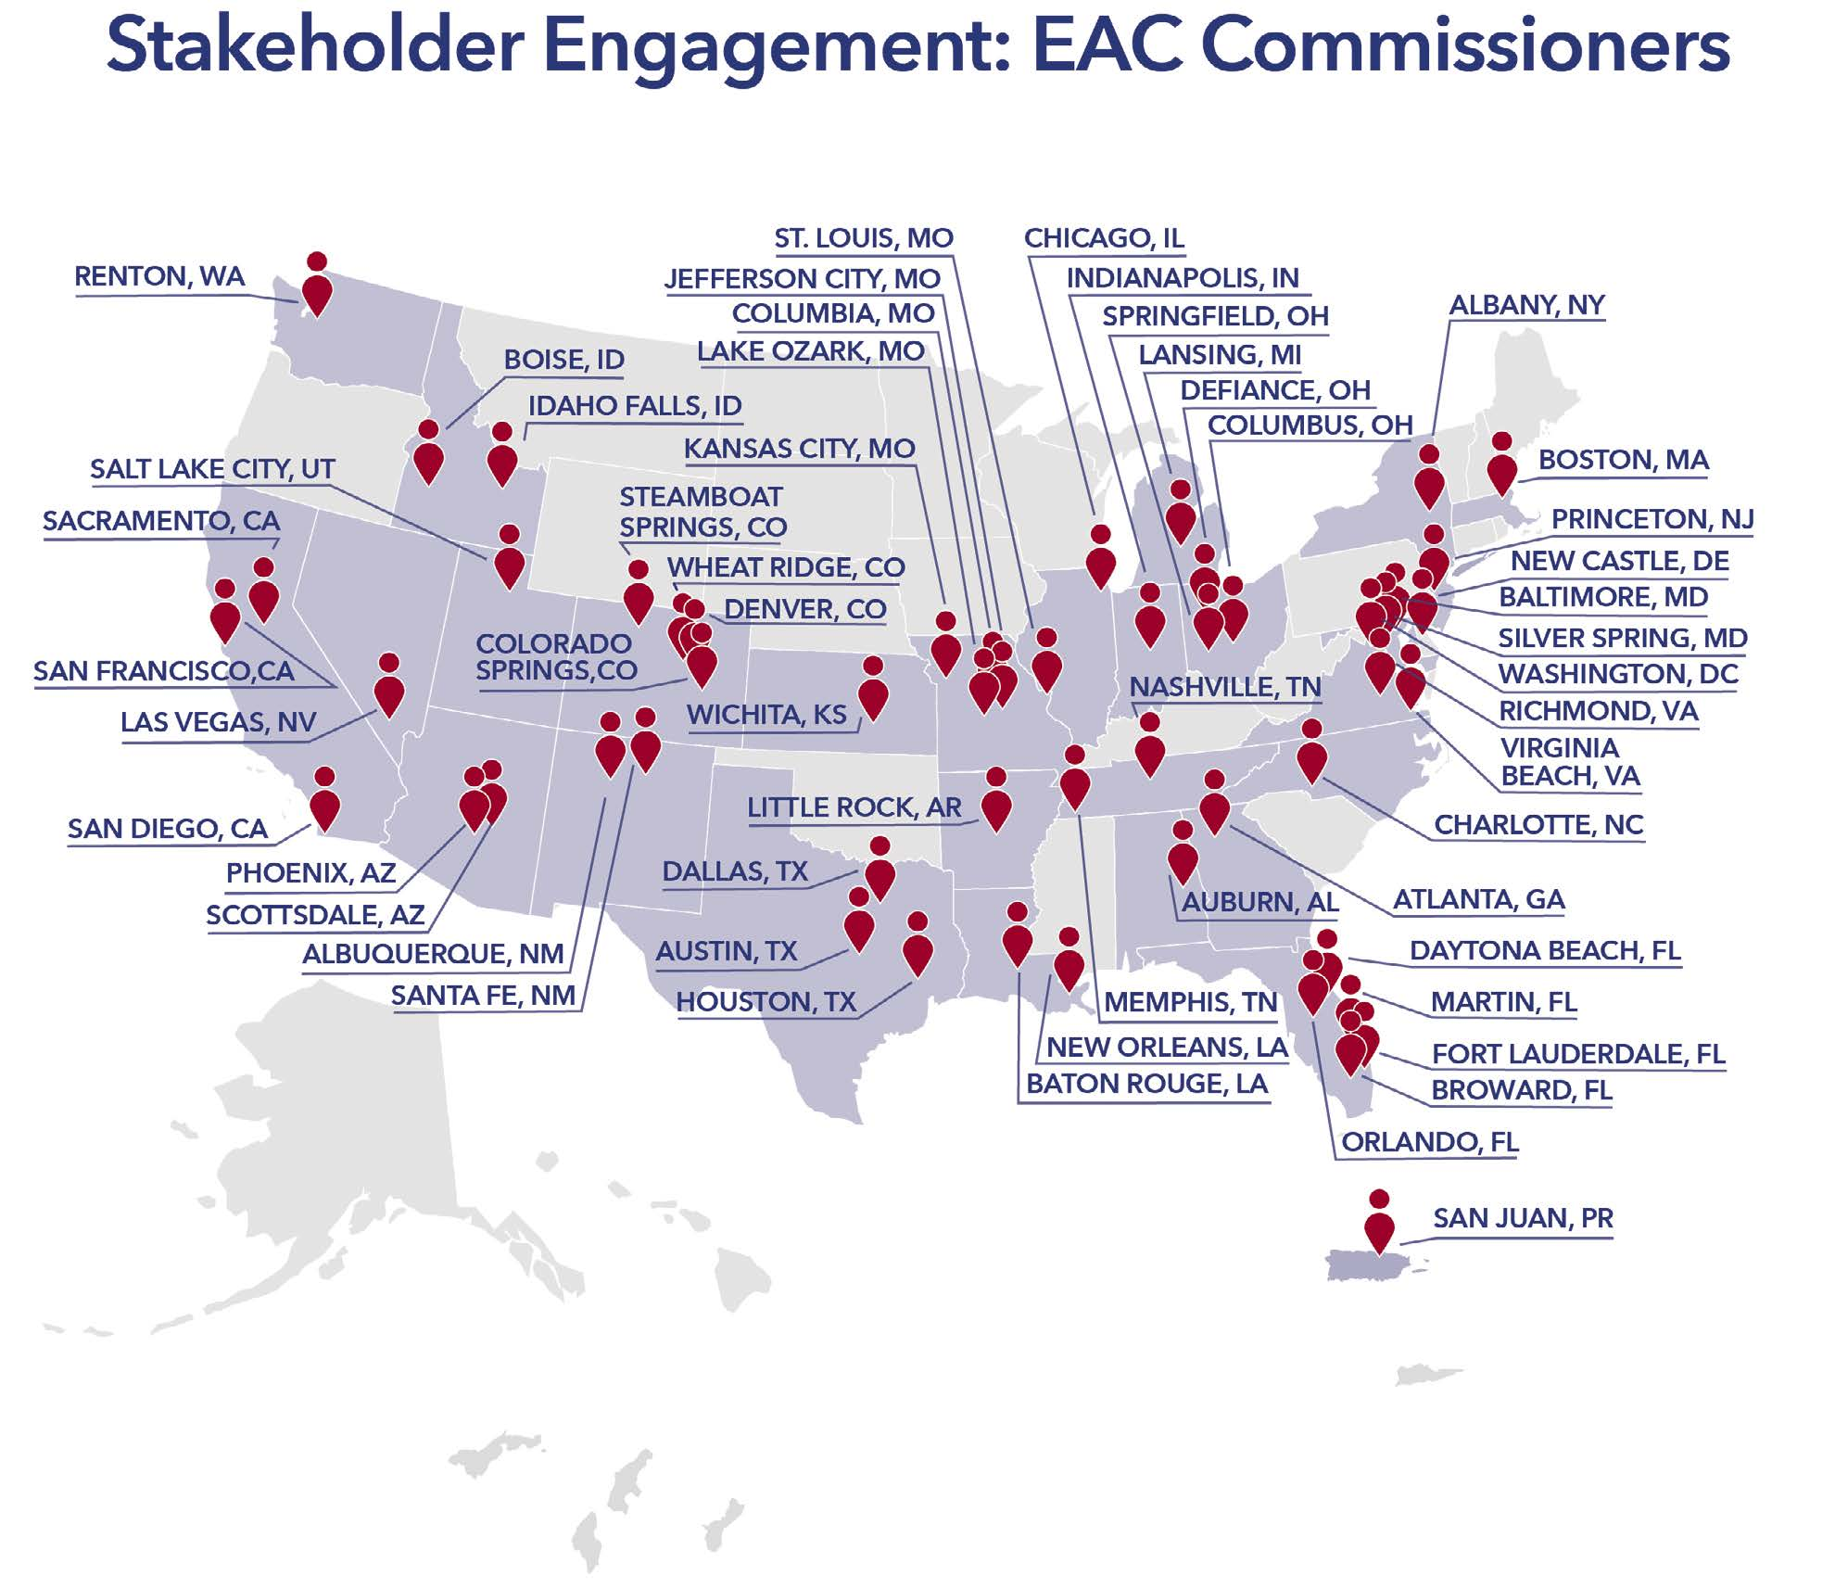
Role of the Commissioners
Commissioners are resources, advisors, and conveners
Recommend guidance and tools to assist with all phases of election administration
Enlist the help of other government agencies, nongovernmental subject area experts, academia and others
Brief Congress, state legislators, and federal officials – firsthand account of election administration from site visits and reports
EAC commissioners traveled to 56 cities in 28 states, the District of Columbia, and Puerto Rico in 2019.

Slide 5
Election
Administrator
Competencies

Slide 6
HAVA Security Grants
FY20 - $425 million in Election Security grants to states
Required 20% state match to the federal funds
__________________________________________________
FY18 - As of September 30, 2019, states spent $92,056,065 (24.2%), of the $380 million allocated
91.2% of funds will be used to improve cybersecurity, purchase new voting equipment or upgrade voter registration systems

Slide 7
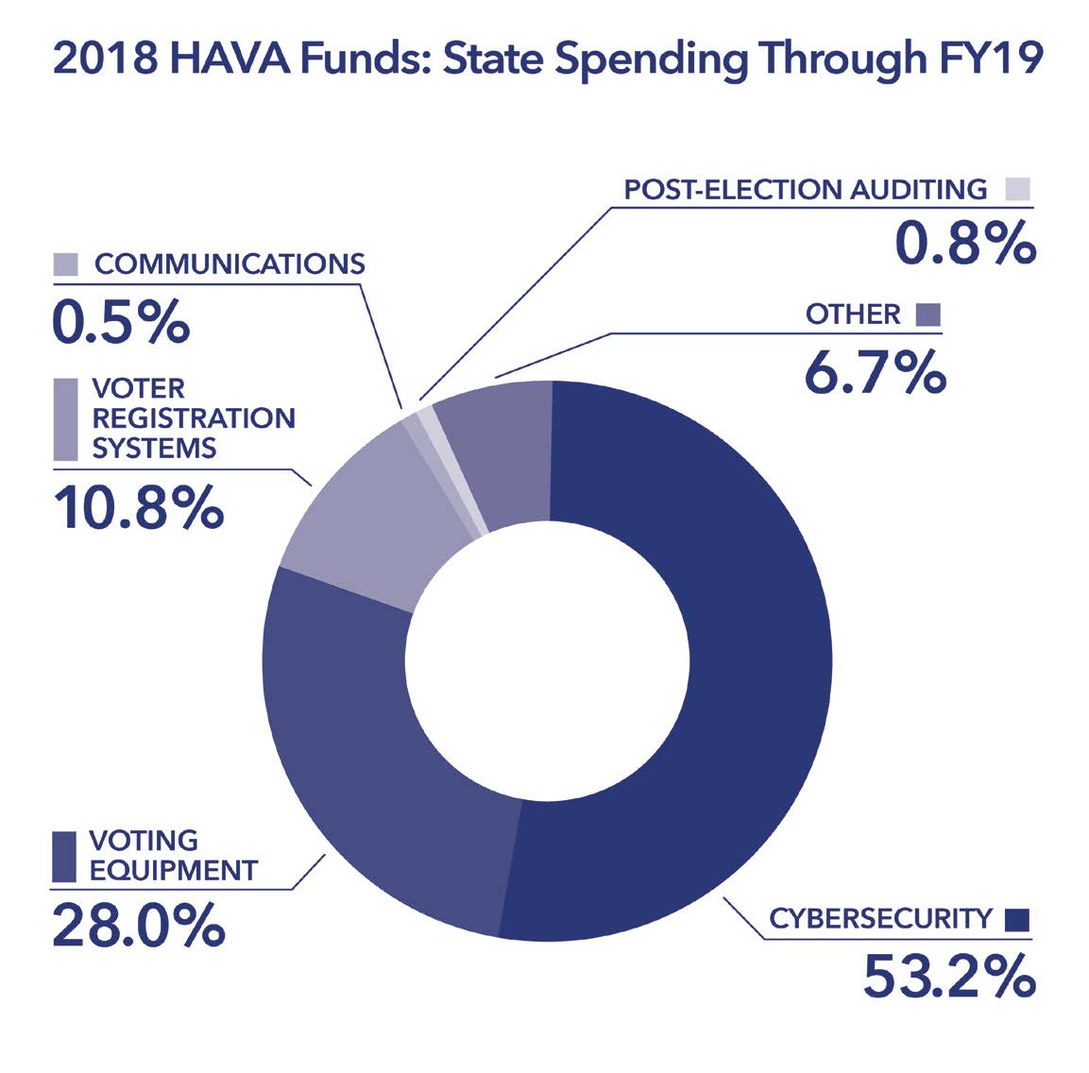
2018 Expenditures by Program Category
Program Category | Amount
Cybersecurity | $48,319,521
Voting Equipment | $18,826,001
Voter Registration | $9,319,521
Other | $6,122,672
Communication | $429,826
Election Auditing | $769,237

Slide 8
2020 CARES Act Distribution of Funds
The CARES Act allocates $400 million in new HAVA funds, to prevent, prepare for, and respond to COVID-19 for the 2020 federal election cycle.
Supplemental federal share of HAVA funding in the CARES Act, by state
■ $3.0m ■ $3.1m-9.9m ■ $10m-$19.9m ■ $20m-$36.3m
WASHINGTON
$8.3m
MAINE
MONTANA
NORTH DAKOTA
MINNESOTA
VERMONT
$3.3m
OREGON
$3.0m
$3.0m
$6.9m
$3.0m
$5.6m
IDAHO
NEW HAMPSHIRE
$3.4m
SOUTH DAKOTA
WISCONSIN
NEW YORK
MASSACHUSETTS
WYOMING
$3.0m
$7.3m
MICHIGAN
$20.5m
RHODE ISLAND
$3.0m
$11.2m
PENNSYLVANIA
NEVADA
NEBRASKA
IOWA
$14.2m
CONNECTICUT
4.5m
UTAH
$3.7m
$4.8m
OHIO
NEW JERSEY
ILLINOIS
INDIANA
$12.8m
WEST VIRGINIA
DELAWARE
$4.3m
COLORADO
$13.9m
$8.0m
MARYLAND
CALIFORNIA
$6.7m
KANSAS
MISSOURI
KENTUCKY
$3.8m
VIRGINIA
MA - $8.3m
$36.3m
$4.6m
$7.6m
$6.1m
$9.5m
TENNESSEE
NORTH CAROLINA
NH - $3.3m
ARIZONA
NEW MEXICO
OKLAHOMA
ARKANSAS
$7.9m
$10.9m
$7.8m
$5.5m
$4.7m
SOUTH CAROLINA
VT - $3.0m
$3.9m
MISSISSIPPI
GEORGIA
$6.3m
$4.7m
ALABAMA
$10.8m
RI - $3.0m
TEXAS
LOUISIANA
$6.5m
$24.4m
$6.2m
CT - $5.4m
FLORIDA
$20.2m
NJ - $10.3m
HAWAII
DE - $3.0m
$3.3m
ALASKA
MD - $7.4m
$3.0m
DC - $3.0m
Sources: US Election Assistance Commission.

Slide 9
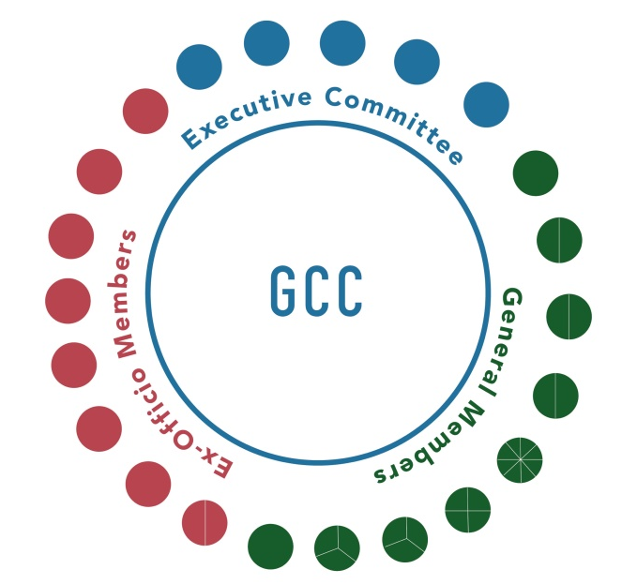
Critical Infrastructure
January 2017, DHS designated U.S. election systems as part of the nation’s critical infrastructure
Designation given to “systems and assets, whether physical or virtual, so vital to the United States that the incapacity or destruction of such systems and assets would have a debilitating impact on security, national economic security, national public health or safety, or any combination of those matters”

Slide 10
GCC and SCC
Government Coordinating Council (GCC)
enables interagency and intergovernmental coordination
comprises representatives across various levels of government (Federal and State, local, tribal and territorial)
EAC plays a leading role
Sector Coordinating Council (SCC)
private sector manufacturer counterpart to the GCC

Slide 11
Elections Government Coordinating Council (GCC)
Executive Committee
Election Assistance Commission (EAC) Chair
Office of Infrastructure Protection, CISA
National Association of Secretaries of State President Directorate
National Association of State Election Directors President
Local Government Election Official
20

Slide 12
Elections Government Coordinating Council (GCC)
General Members
EAC Vice Chair
2 EAC Board of Advisors members
2 EAC Standards Board members
2 EAC Technical Guidelines Development Committee members
8 Secretaries of State/Lieutenant Governors
4 Senior State Election Officials
3 Election Center Representatives
3 iGo members
1 Office of Infrastructure Protection, CISA member
21

Slide 13
Elections Government Coordinating Council (GCC)
General Members
2 EAC
1 State, Local, Tribal and Territorial Government Coordinating Council
1 National Institute of Standards and Technology
1 Federal Voting Assistance Program
1 Office of Cyber and Infrastructure Analysis, CISA
1 Office of Cybersecurity and Communications, CISA
1 Office of Intelligence and Analysis, U.S. Department of Homeland Security
1 Federal Bureau of Investigation
22

Slide 14
Cyber Access and Security Program

Slide 15
CAS Program Overview
The Cyber Access and Security program was launched by the EAC in April, 2020 to provide access to security training, best practices, expertise, and other assistance for election officials tasked with protecting critical election infrastructure.
The program partners with public and private security experts to ensure that election officials have the most up-to-date and best in class information available through the EAC’s Clearinghouse.
PRESENTATION PLACE & DATE

Slide 16
CAS Program Highlights
Beginning in June 2020, the program will begin offering:
Online cybersecurity training developed specifically for election officials
Monthly threat intelligence briefings with a focus on globally emerging threats
In July 2020, the program will launch Risk Management and Crisis Management online workshops for state and territorial election officials.
PRESENTATION PLACE & DATE

Slide 17
CAS Program Highlights
In late summer 2020, the EAC will host a joint CISA online risk management tool on its website allowing election officials at the local level to easily measure and mitigate risks to their specific environments.
CAS is updating materials currently posted to the EAC website and is working to develop new material related to vulnerability disclosure programs, social engineering mitigation, and case studies.
PRESENTATION PLACE & DATE

Slide 18
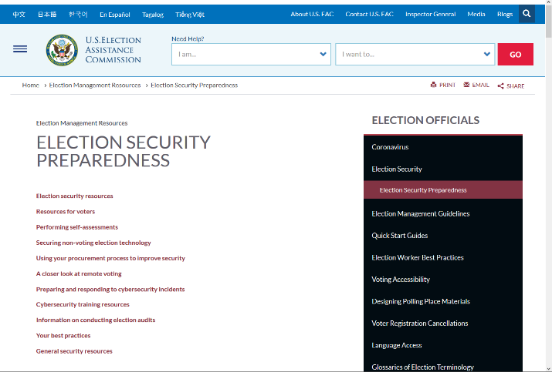
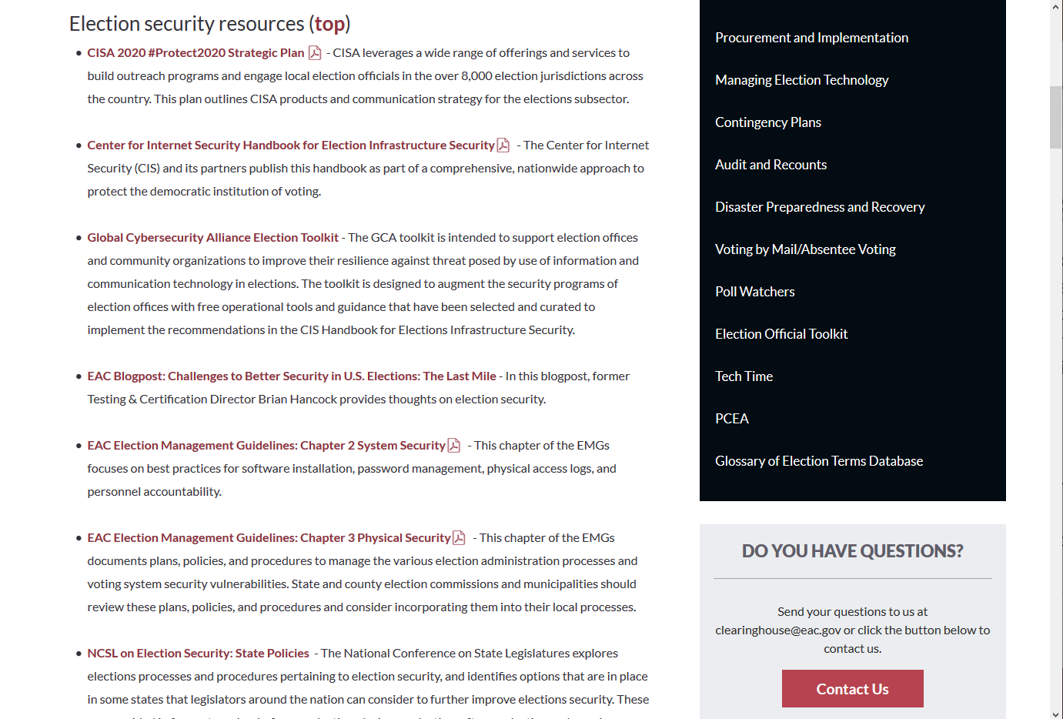
CAS Program Highlights
The program’s Election Security Preparedness page is a one-stop shop for election cybersecurity guidance. It includes resources from federal agencies, non-profits, academia, and local election officials.
The page was recently updated with new guidance on security topics since the 2016 election and reorganized to make the information easier to find and use.
PRESENTATION PLACE & DATE

Slide 19
Key Personnel
Deputy CISO
Joshua Franklin
jfranklin@eac.gov
Sr. Cyber Program Manager
Jessica Bowers
jbowers@eac.gov
Sr. Cyber Analyst
Cal Lassetter
classetter@eac.gov

Slide 20
Testing and Certification Program

Slide 21
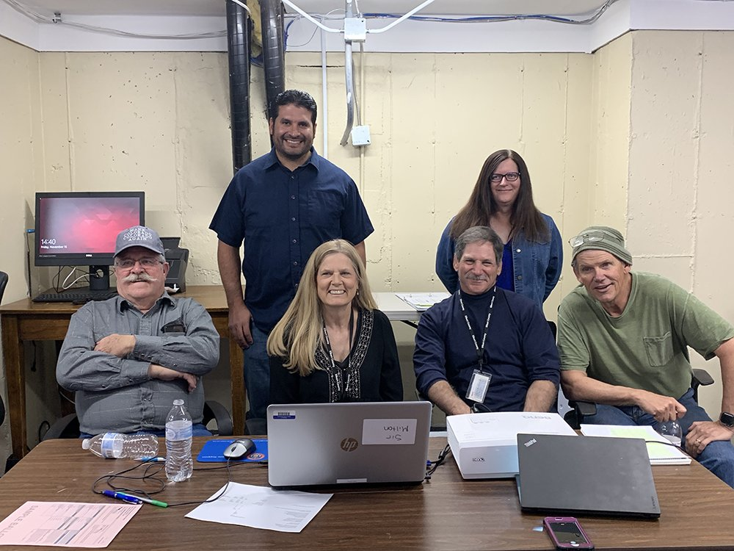
Testing & Certification Overview
Voting system testing and certification of new systems and modifications
Expedited testing and certification for deminimis software changes
Oversee 8 voting system manufacturers and 2 voting system test labs
Provide election administrator support including training and risk-limiting audit support
Agency support for states programs
Voluntary Voting System Guidelines 2.0

Slide 22
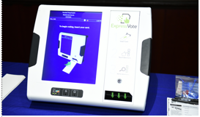
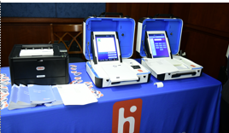
2019 Testing & Certification Highlights
Certified 10 voting systems
Voluntary Voting System Guidelines 2.0
Revised Principles & Guidelines document based on public comments
Draft of VVSG 2.0 Requirements are in Public Comment Phase & EAC Boards Review
Focus on: Security, Accessibility, Functionality
Provided “Election Administrators as IT Managers” training in Ohio, California, and Nevada
Provided risk-limiting audit pilot assistance to counties in Ohio and Pennsylvania

Slide 23
2020 Testing & Certification Goals
Finalize Voluntary Voting System Guidelines 2.0
Publish revised program manuals (T&C Program Manual and VSTL Program Manual)
Conduct manufacturing site audits
Conduct voting system test lab audits
Conduct field reviews of EAC-certified voting systems
Implement additional vulnerability review and penetration testing into the Testing & Certification Program
Implement a voluntary non-voting election technology review program⁻ Voter Registration Systems, Electronic Poll Books, Election Night Reporting, Ballot Delivery Systems
Notes:
1. Provide a voluntary review of non-voting election technology such as electronic poll books, ballot delivery systems, election night reporting, ballot on demand systems, and other pertinent technology. Provide a clearinghouse for state-level testing of these technologies (i.e. Indiana and Virginia’s electronic poll book test reports).

Slide 24
Key Personnel
Director, Voting System Testing & Certification
Jerome Lovato,
jlovato@eac.gov
Senior Election Technology Specialist
Paul Aumayr,
paumayr@eac.gov
Senior Election Technology Specialist
Eugene Burton
eburton@eac.gov
Election Technology Specialist
Jessica Fleming
jfleming@eac.gov

Slide 25
Contact Us
Vice Chairman
Don Palmer
(202)744-1862
dpalmer@eac.gov
@VotingGuy

